Slide 1
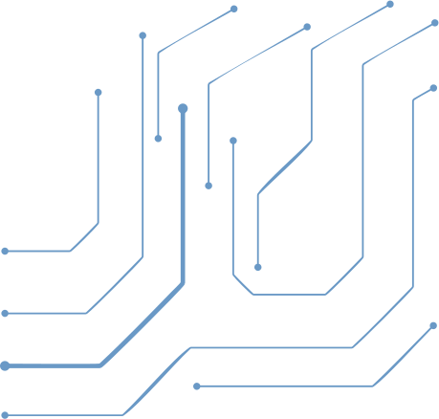


SMART SIGN
HAND GESTURES
Final Presentation
Made By Team 1
ROUND 3

Slide 2
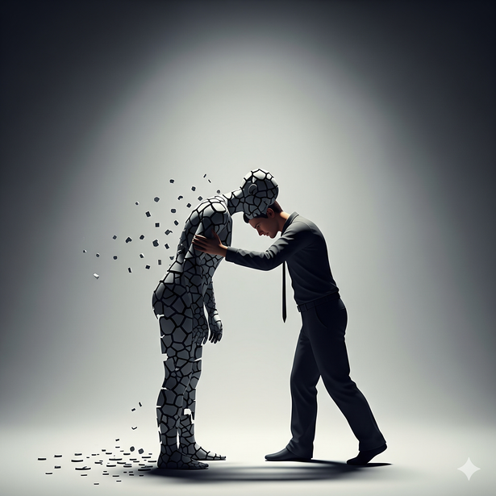


THE PROBELM
4B2G
Problem Definition:
People with speech or hearing impairments face daily communication barriers in simple tasks and social interactions. This project aims to reduce these challenges by creating a real-time sign-language recognition system using computer vision and deep learning to improve accessibility and inclusion.
CHALLENGES :
Communication
Barriers
Dependence
on Others
Emotional Struggles

Slide 3
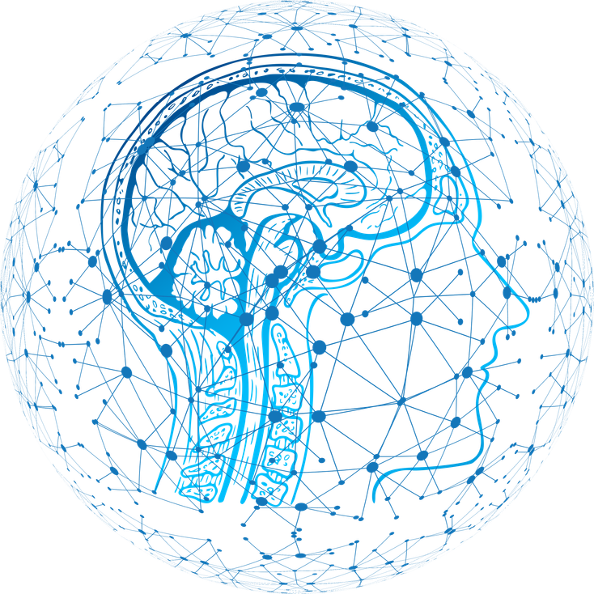
PROJECT OVERVIEW
4B2G
System Overview:
The system operates in two modes:
1. Letter Recognition Mode (Done)
  Recognizes static ASL letters in real time.
  Fully trained and deployed with high accuracy.
  Lets users form words and sentences letter-by-letter.
2. Video-Based Word & Sentence Mode (In Progress)
  Targets dynamic gesture recognition using MediaPipe keypoints.
  Aims to interpret full words and sentences.
  Currently limited by dataset availability and motion complexity.
Goal
Build a scalable foundation for a complete, real-time sign-language interpretation system.
Poppins

Slide 4
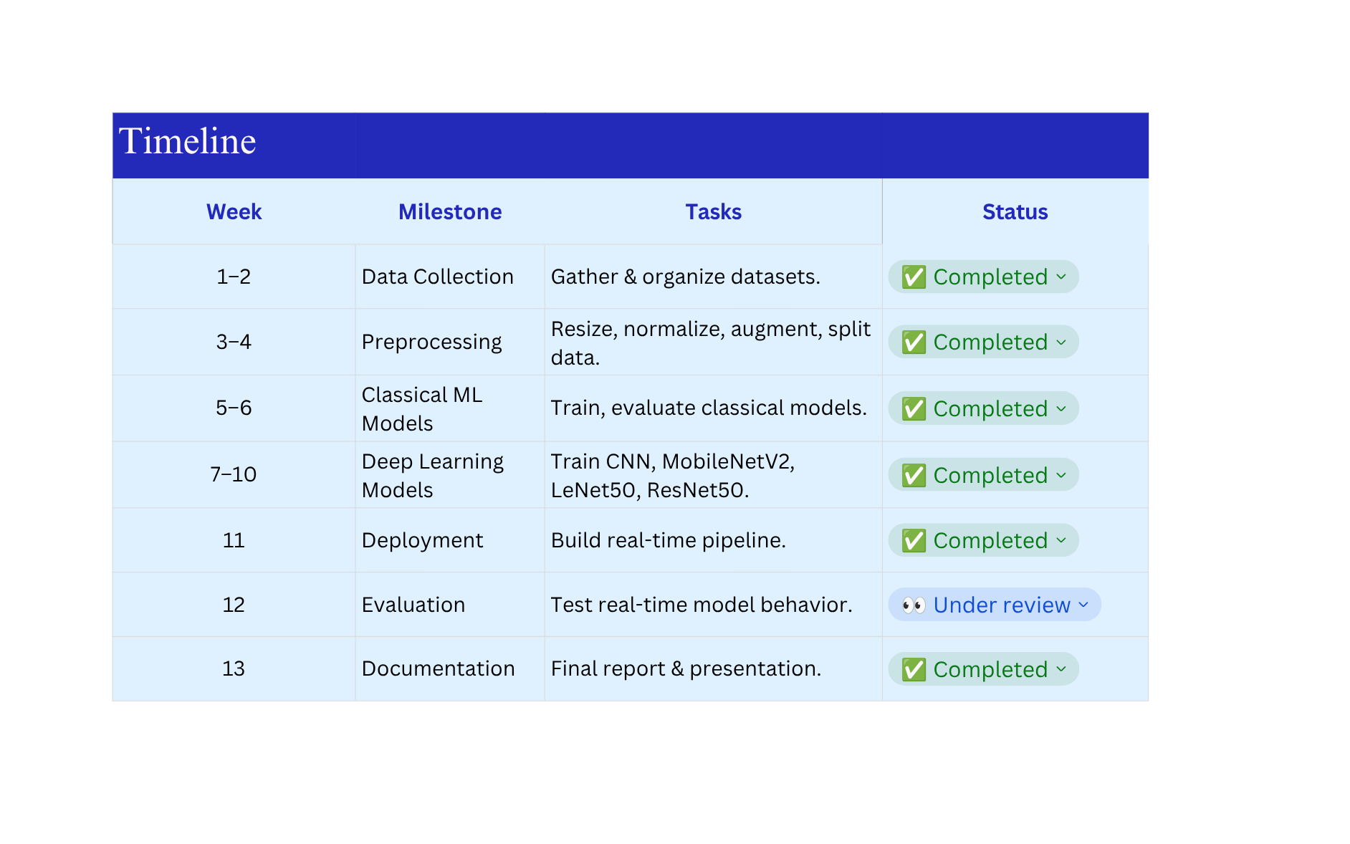
TIMELINE PLANNING
4B2G

Slide 5
COLLECTION & PREPROCESSING
4B2G
Sources
  Public datasets from Kaggle (ASL Alphabet, Sign Language MNIST) in total 86,764 training images.
  WLASL videos processed with MediaPipe to extract hand/body keypoints.
Augmentation
  Images: rotation, zoom, shifts, shear (no flipping).
  Videos: slight noise, frame shifting, small speed variation.
Data Splits
  Images: 70% train / 15% val / 15% test
  Videos: 80% train / 20% val-test
Final Validation
  Verified shapes, normalization, labels, class balance, and sample quality.
Data Preprocessing
  Preprocessing ensures clean, consistent inputs for accurate model training.
Key Steps
  Resize images to 28×28 grayscale.
  Convert video samples to 30×171 key point matrices.
  Normalize features and remove irrelevant classes .

Slide 6
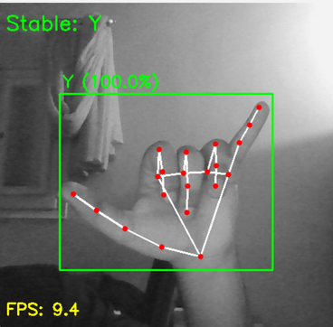
MODEL DEVELOPMENT PLAN
4B2G
Classical Machine Learning Models
  Logistic Regression — baseline, low performance (~14%).
  HistGradient Boosting — high accuracy (~95%), but unstable with real-world variation.
  Random Forest — strong results (~93–94%).
  XGBoost — best classical model (~95%).
  Real-time simulation revealed major drops, showing classical models are sensitive to noise and unsuitable for deployment or real-time.
Deep Learning Models
  CNN Model — 92.5% accuracy; good real-time stability.
  MobileNetV2 — 95.2% accuracy; very efficient for deployment.
  LeNet50 — (96.44%); strong per-class performance.
  ResNet50 (Fine-Tuned) ~98% highest accuracy ; captures complex features
Key Conclusion:
  Pre-trained models, especially LeNet50 and ResNet50, provide the best balance of accuracy, robustness, and deployability

Slide 7
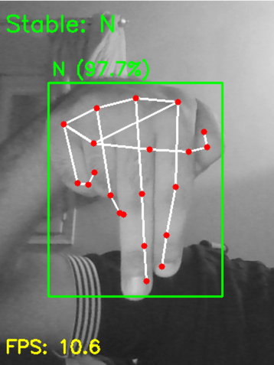
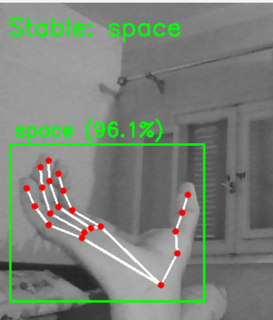
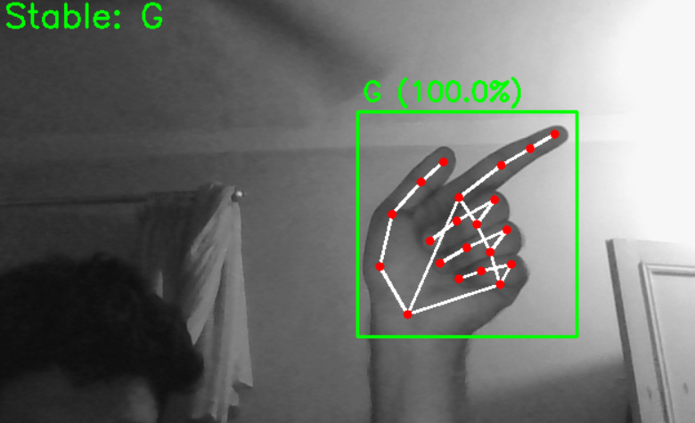
TEST CASES
4B2G
Test Case Overview:
ID: TC001
Description: Verify ASL hand gesture recognition.
Environment: Python, TensorFlow, OpenCV, Mediapipe, Webcam
Test Steps:
  Launch the Smart Sign application.
  Activate webcam.
  Perform a hand gesture.
  Observe the predicted letter.
  Repeat for all letters in the test set.
✅
✅
✅
Notes:
  Gestures must stay in the ROI box for accurate prediction.
  Background clutter can reduce accuracy slightly.

Slide 8
SUMMARY OF MODEL DEVELOPMENT
4B2G
CNN
RESNET50
2
5
FROM 27 → 89
FROM 93 → 95
1
FROM 89 → 91
4
ML Model
LENET50
FROM 91 → 93
3
6
CNN OPTIMIZED
REAL TIME - TESTING

Slide 9
4B2G
DEPLOYMENT PLAN
System Integration
Accessibility Focus
  Real-time prediction pipeline using CNN/LeNet50/MobileNetV2.
  Processes webcam input → preprocess → classify → display output.
  Clear UI design, large fonts, high contrast.
  Inclusive of variations in hand size, lighting, and backgrounds.
Tools & Platforms
Future Enhancements
  Flask / Streamlit for user interface.
  OpenCV, TensorFlow/Keras, MediaPipe for processing.
  Optional cloud deployment on AWS / Azure / GCP.
  Full integration of video-based BiLSTM model.
  Cloud scalability and multi-user support.
  Automated retraining and monitoring (MLOps).
Real-Time Testing & Monitoring
  Live video testing with accuracy/latency tracking.
  Alerts for model drift or inconsistent patterns.

Slide 10
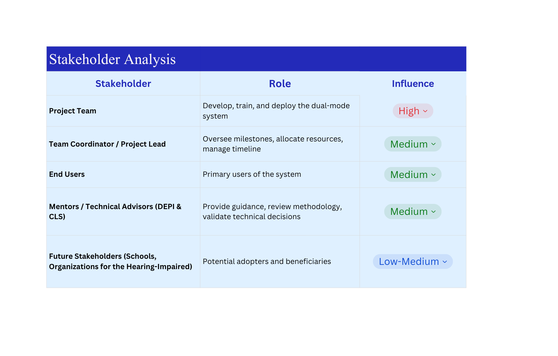
STAKEHOLDER ANALYSIS
4B2G

Slide 11
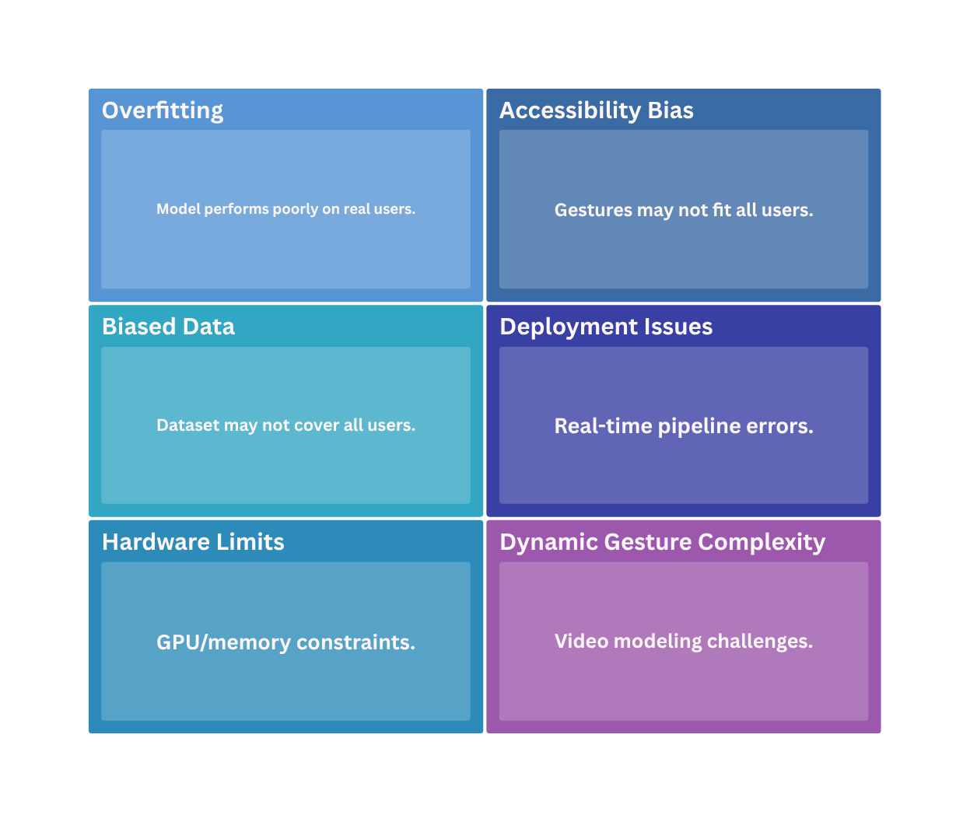
RISK ANALYSIS
4B2G

Slide 12
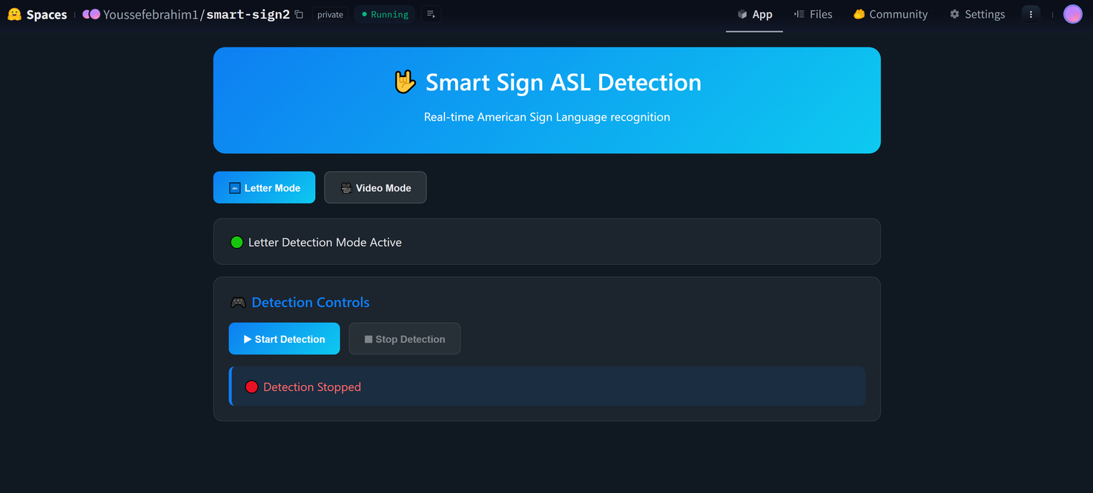
UI / UX
4B2G
The UI/UX design of the dual-mode ASL gesture recognition system ensures intuitive interaction, accessibility, and real-time responsiveness for both static letter recognition and dynamic video-based word/sentence prediction.
User Interaction Flow
  Select Mode: Letter or sentence mode.
  Active Camera: Live input
  perform gesture : System capture frames and extracts features.
  View Prediction : Letters or words displayed in real-time , confidence level shown
  Feedback / Retry: System indicates unclear gestures
  Save / History : User can review previous predictions .

Slide 13
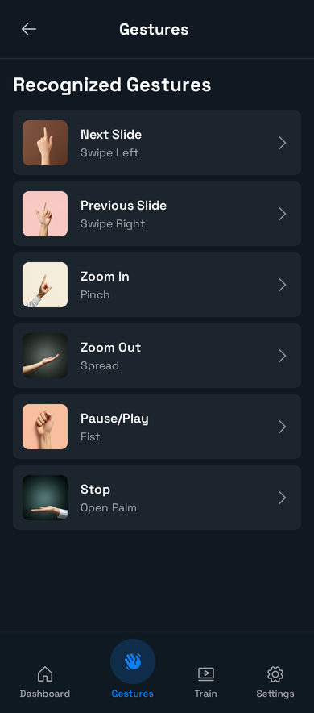
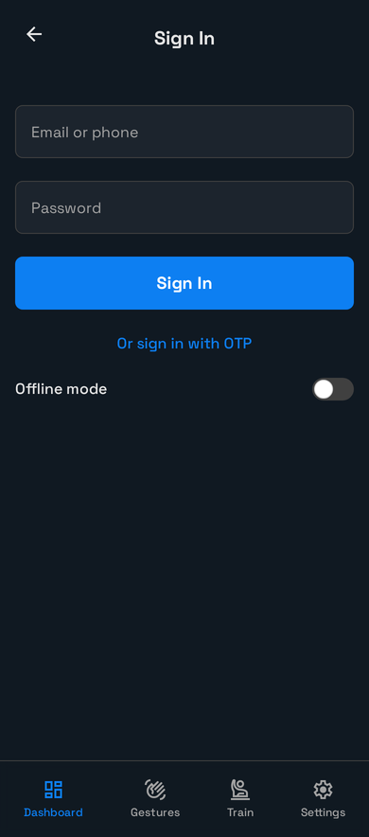
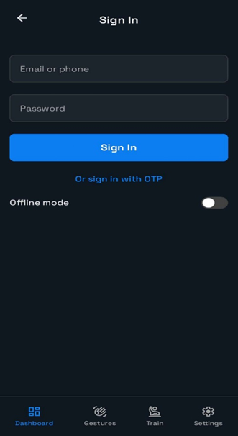
4B2G
FUTURE ENHANCEMENTS
Develop Advanced Dual Mode & Public Deployment
Interactive guided tutorials for users.
Mobile and tablet-friendly UI
Custom gesture addition for personal use

Slide 14
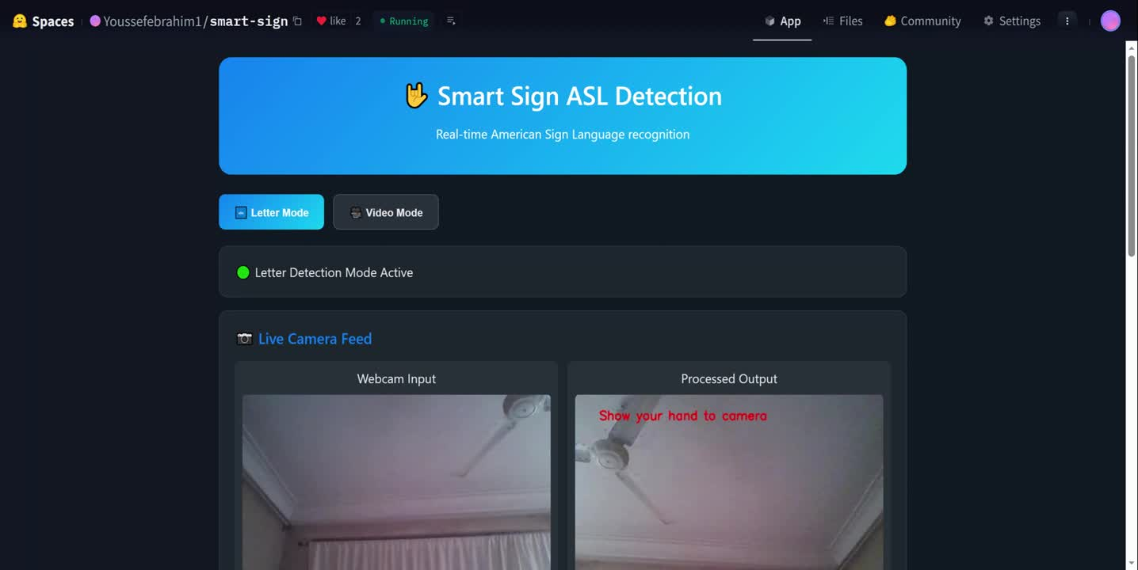
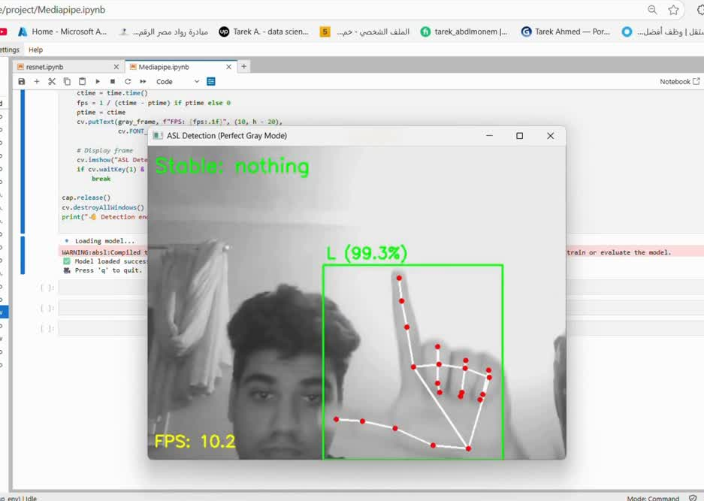
4B2G
DEMO

Slide 15
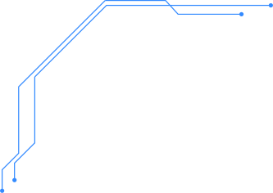

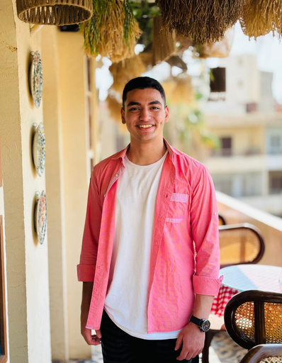



4B2G
MEET OUR TEAM
Youssef Ebrahim
Ziad Mahmoud
Wesam Karam
Demiana Antonius
Tarek Ahmed
Mostafa Ahmed

Slide 16
THANK YOU
Made By Team 1

